Slide 1


Disaster Tracking System
Student: Shyaka Vivance (ID: 27237)
2024-2025 Academic Year

Slide 2

Project Overview
This project aims to address the challenges of managing and responding to natural disasters, such as floods, earthquakes, and hurricanes
Designed to support different users, such as citizens, response teams, administrators, and NGOs
The solution integrates Oracle Database, PL/SQL, GitHub for versioning, BPMN.io for process modeling, and OEM Express for monitoring.
Key features: structured reporting, audit logging, automated workflows ,and SLA compliance.

Slide 3
Problem
Current disaster response systems lack centralized control, timely communication, and data traceability.
System Goal
Automate data entry, validate and classify reports, assign response teams, and log all actions securely.
Requirements and Scope
Use Cases
Digital transformation requires embracing change, adapting to new technologies, and collaborating effectively.
Scope
Users & Stakeholders
Focused on database logic, audit control, and BPMN-modeled workflows.
Citizens, Admins, Government Agencies, Response Teams, NGOs.

Slide 4
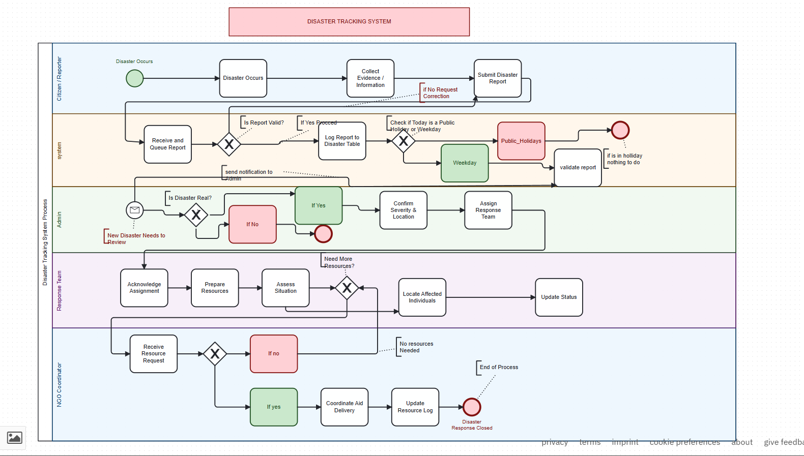
BPMN Modeling
Used bpmn.io to model the entire disaster reporting and resolution workflow.
Swimlanes:
Citizen/Reporter: Triggers disaster events, submits reports
System: Validates input, logs data, restricts operations on holidays
Admin: Confirms severity, assigns teams
o Response Team: Executes actions, evaluates needs, locates individuals
NGO Coordinator: Delivers aid, coordinates supplies
Includes:
Message Flows between lanes (e.g., Citizen → System)
Exclusive Gateways for conditions (e.g., “Is report valid?”)
Output: Exported
.bpmn and .png for documentation

Slide 5
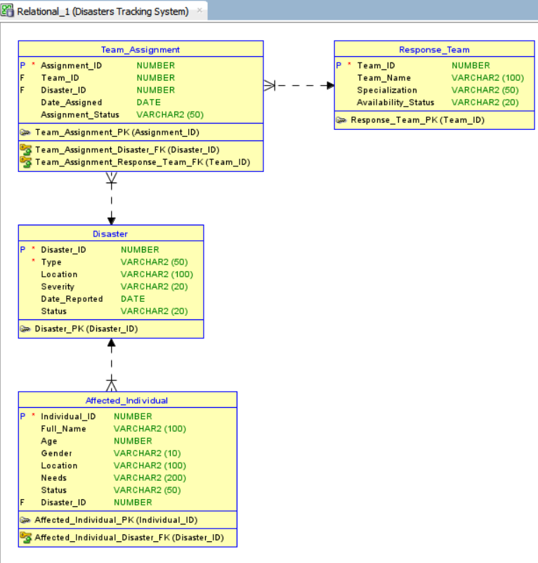
ERD Design
Entity-Relationship Diagram captures logical structure of the database.
Key Entities:
Disaster(id, type, location, severity, date, status)
Response_Team(id, name, specialty, availability)
Resource(id, name, type, quantity)
Affected_Individual(id, name, age, status, disaster_id)
Team_Assignment(team_id, disaster_id, assigned_date)
Constraints: PKs, FKs, unique indexes.
Normalization: Applied to 3rd Normal Form (3NF) to eliminate redundancy.
Tools used: SQL Developer ERD viewer, optionally verified in draw.io

Slide 6
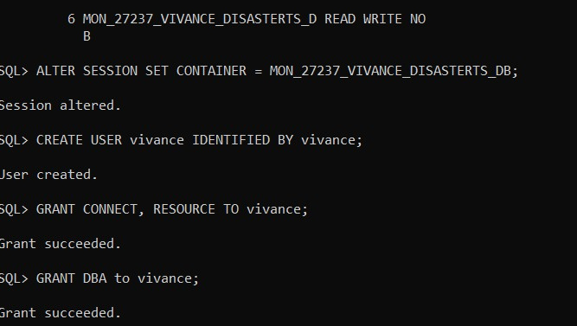
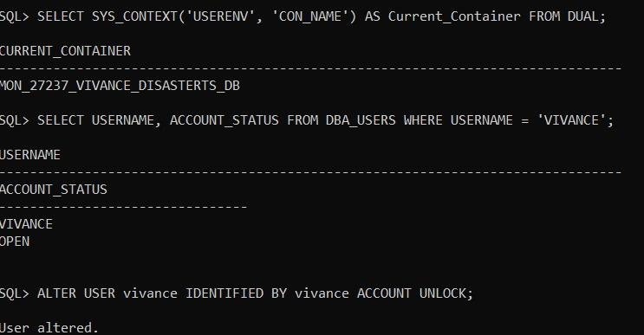
Database Setup
Entity-Relationship Diagram captures logical structure of the database.
Created schema using SQL:
CREATE TABLE Disaster (...);
CREATE TABLE Response_Team (...);
CREATE TABLE Resource (...);
Created schema using SQL:
CREATE USER vivance IDENTIFIED BY password;
GRANT CONNECT, RESOURCE TO vivance;
Created schema using SQL:
ALTER SESSION SET CONTAINER = MON_27237_VIVANCE_DISASTERTS_DB;
Confirmed container name using:
SELECT SYS_CONTEXT('USERENV','CON_NAME') FROM DUAL;

Slide 7
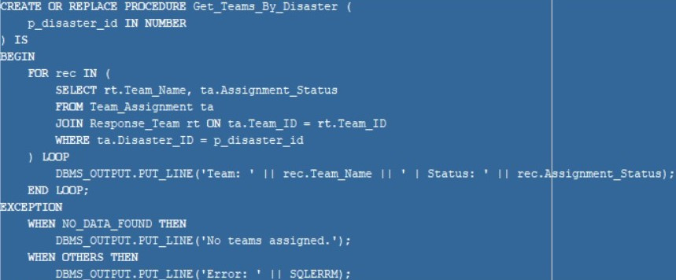
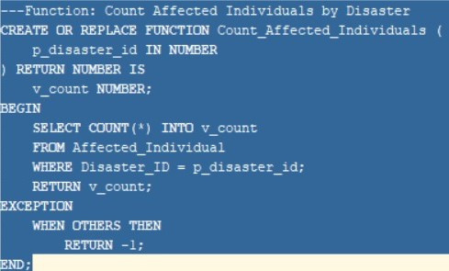
PL/SQL Logic
Entity-Relationship Diagram captures logical structure of the database.
Encapsulated complex logic via:
o Procedure: Assign team to disaster
o Function: Count affected individuals by disaster
Code examples:
PROCEDURE Assign_Team(p_disaster_id IN NUMBER, p_team_id IN NUMBER) IS BEGIN ... END;
FUNCTION Count_Affected(p_disaster_id IN NUMBER) RETURN NUMBER IS ...
Wrapped into PL/SQL Package:
CREATE OR REPLACE PACKAGE pkg_disaster_ops AS ... END;
Benefits:
Reusability, clarity, modular testing

Slide 8
01
Improved command of Oracle DB & PL/SQL (procedures, functions, triggers)
02
Developed process-oriented thinking through BPMN modeling
04
03
Integrated OEM Express for live database monitoring
Used GitHub for structured collaboration and backup
Lessons Learned

Slide 9

Benefits of the Disaster Tracking System & Tools Used
Benefits of the Disaster Tracking System:
Tools Used:
Centralized Control: Streamlines disaster reporting and response coordination
Automated Workflows: Validates reports, assigns teams, and tracks SLAs
Audit Compliance: Logs all actions with timestamps and user details
Improved Response Times: Timer-based SLAs ensure rapid team deployment
Data Integrity: 3NF-normalized database with referential constraints
Oracle SQL Developer: Database design & PL/SQL development
BPMN.io: Process modeling for disaster workflows
OEM Express: Real-time database monitoring
GitHub: Version control & collaboration
SQL*Plus: SYS-level database configuration

Slide 10
REFERENCES:
Contact: shyaka.vivance@auca.ac.rw
Github: https://github.com/Vivance-Shyaka/Mon_27237_Vivance_Disastertracking_db
Feel free to ask questions on logic, design, or deployment
Ready for demo or walkthrough of SQL/GitHub/OEM/BPMN components
THANK YOU!
"We cannot stop disasters, but we can prepare with knowledge." — Thank you

